Slide 1

LECTURE 2
H E L L O W O R L D A N D D E S T R O Y
DEPLOY
DANIEL R YS JAN VÁCL AVÍK

Slide 2
O V E R V I E W
What is Ionic
How does a mobile applications work
Create basic project
Dev tools (Chrome, Safari)
Deploy on device
Via cabel
Remotely
2/53

Slide 3
W H AT I S I O N I C ?
3/53

Slide 4
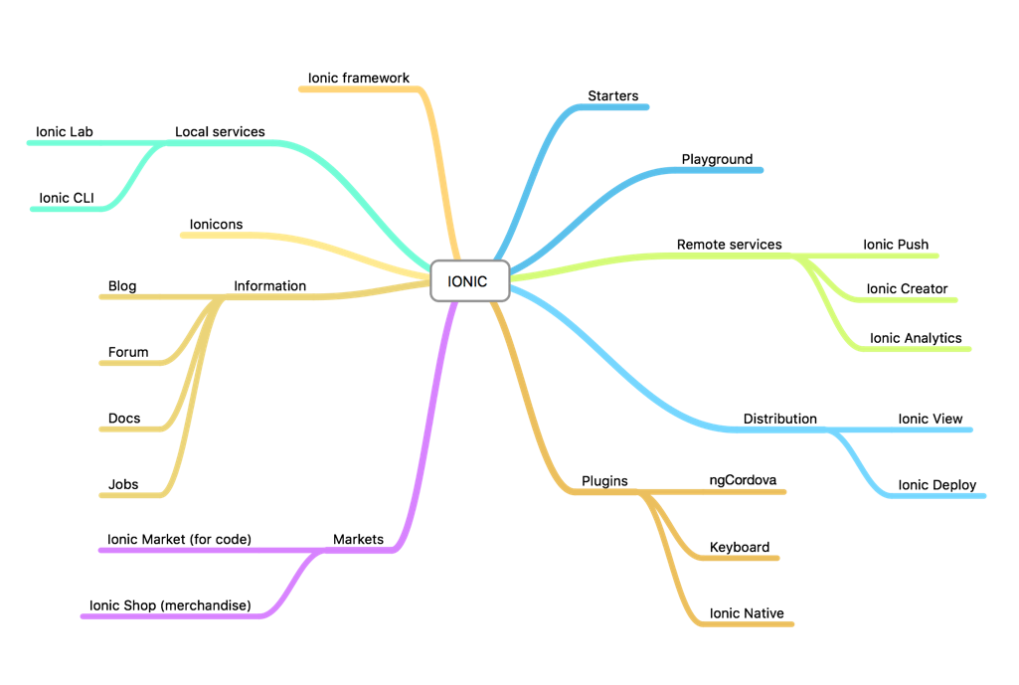
W H AT I S I O N I C ?
4/53

Slide 5

W H AT I S I O N I C ?
90% of o u r
co u r se
5/53

Slide 6
H O W D O E S A
M O B I L E A P P L I C AT I O N W O R K ?
6/53

Slide 7
NATIVE MOBILE APPLICATION
ANDROID OS
7/53

Slide 8
NATIVE MOBILE APPLICATION
Mobile API’s
Sensors (Gyroscope, Accelerometer,…)
Interactions (Touch, Keyboard,…)
Services (Notifications, Camera,…)
ANDROID OS
8/53

Slide 9
NATIVE MOBILE APPLICATION
Activity
Mobile API’s
Sensors (Gyroscope, Accelerometer,…)
Interactions (Touch, Keyboard,…)
Services (Notifications, Camera,…)
ANDROID OS
9/53

Slide 10
Core library
NATIVE MOBILE APPLICATION
Activity
Mobile API’s
Sensors (Gyroscope, Accelerometer,…)
Interactions (Touch, Keyboard,…)
Services (Notifications, Camera,…)
ANDROID OS
10/53

Slide 11
View
NATIVE MOBILE APPLICATION
Core library
Activity
Mobile API’s
Sensors (Gyroscope, Accelerometer,…)
Interactions (Touch, Keyboard,…)
Services (Notifications, Camera,…)
ANDROID OS
11/53

Slide 12
View
NATIVE MOBILE APPLICATION
Service
Core library
Activity
Mobile API’s
Sensors (Gyroscope, Accelerometer,…)
Interactions (Touch, Keyboard,…)
Services (Notifications, Camera,…)
ANDROID OS
12/53

Slide 13
ListView
NATIVE MOBILE APPLICATION
View
Service
Core library
Activity
Mobile API’s
Sensors (Gyroscope, Accelerometer,…)
Interactions (Touch, Keyboard,…)
Services (Notifications, Camera,…)
ANDROID OS
13/53

Slide 14
ListView
NATIVE MOBILE APPLICATION
View
Intent
Service
Core library
Activity
Mobile API’s
Sensors (Gyroscope, Accelerometer,…)
Interactions (Touch, Keyboard,…)
Services (Notifications, Camera,…)
ANDROID OS
14/53

Slide 15
W H AT I F W E U S E C O R D O VA ?
NATIVE MOBILE APPLICATION
ListView _{View}
Intent
Core library Activity ^{Service}
Mobile API’s
• Sensors (Gyroscope, Accelerometer,…)
• Interactions (Touch, Keyboard,…)
• Services (Notifications, Camera,…)
ANDROID OS
15/53

Slide 16
CORDOVA APPLICATION
Mobile API’s
• Sensors (Gyroscope, Accelerometer,…)
• Interactions (Touch, Keyboard,…)
• Services (Notifications, Camera,…)
MOBILE OS
16/53

Slide 17
WebView
CORDOVA APPLICATION
Mobile API’s
• Sensors (Gyroscope, Accelerometer,…)
• Interactions (Touch, Keyboard,…)
• Services (Notifications, Camera,…)
MOBILE OS
17/53

Slide 18
Web application
CORDOVA APPLICATION
HTML, CSS, JS (+ Ionic Framework)
WebView
Mobile API’s
• Sensors (Gyroscope, Accelerometer,…)
• Interactions (Touch, Keyboard,…)
• Services (Notifications, Camera,…)
MOBILE OS
18/53

Slide 19
Web application
CORDOVA APPLICATION
Cordova plugins
File
Notifications
Camera
…
HTML, CSS, JS (+ Ionic Framework)
WebView
Mobile API’s
• Sensors (Gyroscope, Accelerometer,…)
• Interactions (Touch, Keyboard,…)
• Services (Notifications, Camera,…)
MOBILE OS
19/53

Slide 20
C R E AT E B A S I C P R O J E C T ON IONIC

Slide 21
C R E AT E N E W P R O J E C T
$ cd ~/my-ionic-projects/
$ ionic start my-first-app
tabs

Slide 22

C R E AT E N E W P R O J E C T
Navigate to your folder
where you want to place project
$ cd ~/my-ionic-projects/
$ ionic start my-first-app
tabs

Slide 23

C R E AT E N E W P R O J E C T
Navigate to your folder
where you want to place project
$ cd ~/my-ionic-projects/
$ ionic start my-first-app
tabs
App name (dir name)

Slide 24

C R E AT E N E W P R O J E C T
Navigate to your folder
where you want to place project
$ cd ~/my-ionic-projects/
$ ionic start my-first-app
tabs
Starter template
App name (dir name)

Slide 25
R U N S E R V E R
$ cd my-first-app
$ ionic serve

Slide 26

R U N S E R V E R
Navigate to project folder
$ cd my-first-app
$ ionic serve

Slide 27

R U N S E R V E R
Navigate to project folder
$ cd my-first-app
$ ionic serve [--lab]
Start server

Slide 28
B R O W S E R S
No Internet Explorer
No Firefox
No Safari
Use Chrome / Chromium
Because of Web-kit and Dev Tools

Slide 29
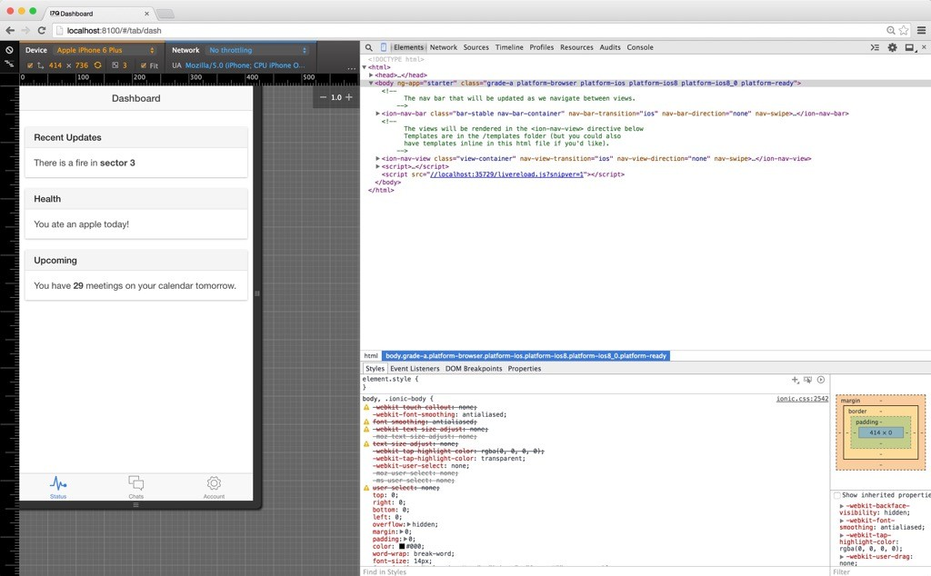
OLA
29
/53

Slide 30
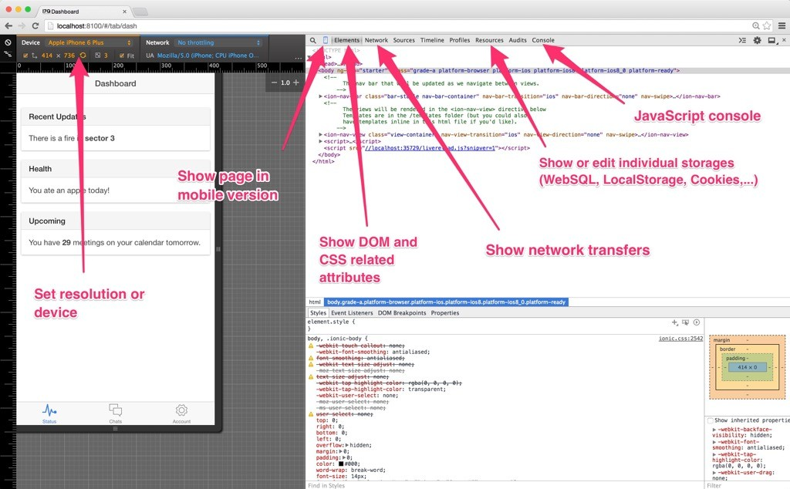
C H R O M E D E V T O O L S
30
/53

Slide 31
C O R D O VA C O N F I G
config.xml
<?xml version="1.0" encoding="UTF-8" standalone="yes"?>
<widget id="com.ionicframework.example" version="0.0.1" xmlns="http:// www.w3.org/ns/widgets" xmlns:cdv="http://cordova.apache.org/ns/1.0">
<name>Your app name</name>
<description>
An Ionic Framework and Cordova project.
</description>
<author email="hi@ionicframework" href="http://ionicframework.com/">
Ionic Framework Team
</author>
<content src="index.html"/>
<access origin="*"/>
<preference name="webviewbounce" value="false"/>
<preference name="UIWebViewBounce" value="false"/>
<preference name="DisallowOverscroll" value="true"/>
<preference name="android-minSdkVersion" value="16"/>
<preference name="BackupWebStorage" value="none"/>
<preference name="SplashScreen" value="screen"/>
<preference name="SplashScreenDelay" value="3000"/>
<preference name="Orientation" value="landscape"/>
<preference name="target-device" value="tablet"/>
<feature name="StatusBar">
<param name="ios-package" value="CDVStatusBar" onload="true"/>
</feature>
</widget>

Slide 32

D E P L O Y

Slide 33
A D D P L AT F O R M S
$ cordova platform add android
or
$ cordova platform add ios

Slide 34

A D D P L AT F O R M S
$ cordova platform add android
or
$ cordova platform add ios
iOS only for Mac OS X

Slide 35
T W O W AY S F O R D E P L O Y I N G A P P S O N D E V I C E
Via cable
Remotely
Ionic View

Slide 36
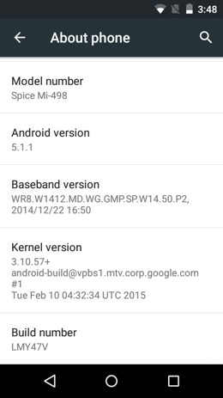

E N A B L E D E V E L O P E R M O D E
Settings > About phone > Build number
Click 7 times!
Source: www.androidpure.com

Slide 37
C O N N E C T D E V I C E
Check devices (Android only)
$ adb devices
List of devices attached GII7D6RGR8Y9TSS4 device

Slide 38
R U N O N D E V I C E V I A C A B L E
$ cordova run android
or
$ cordova run ios

Slide 39
G E T L O G S F R O M D E V I C E
(Android only)
$ adb $ adb | logcat logcat | | | grep | "Web Console"
$ adb | logcat | | | grep | "Chromium"
$ adb | logcat | | | grep | "Exception"

Slide 40
R U N R E M O T E LY V I A I O N I C V I E W

Slide 41
S I G N U P T O I O N I C . I O
https://apps.ionic.io/signup

Slide 42
U P L O A D Y O U R A P P
$ ionic | login | // | Needed | only | once
$ ionic | upload

Slide 43
S H A R E W I T H T E S T E R S
Sending app invite for others
$ ionic share space@director.com

Slide 44


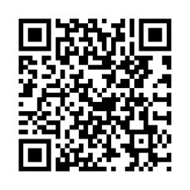
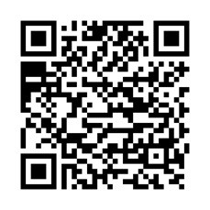
D O W N L O A D I O N I C V I E W
O N Y O U R D E V I C E

Slide 45
I O N I C C R E AT O R
For fast prototyping
Exports prototypes directly to the code
creator.ionic.io

Slide 46
H O M E W O R K
Create prototype with Ionic Creator
Assignment https://goo.gl/guAstQ

Slide 47
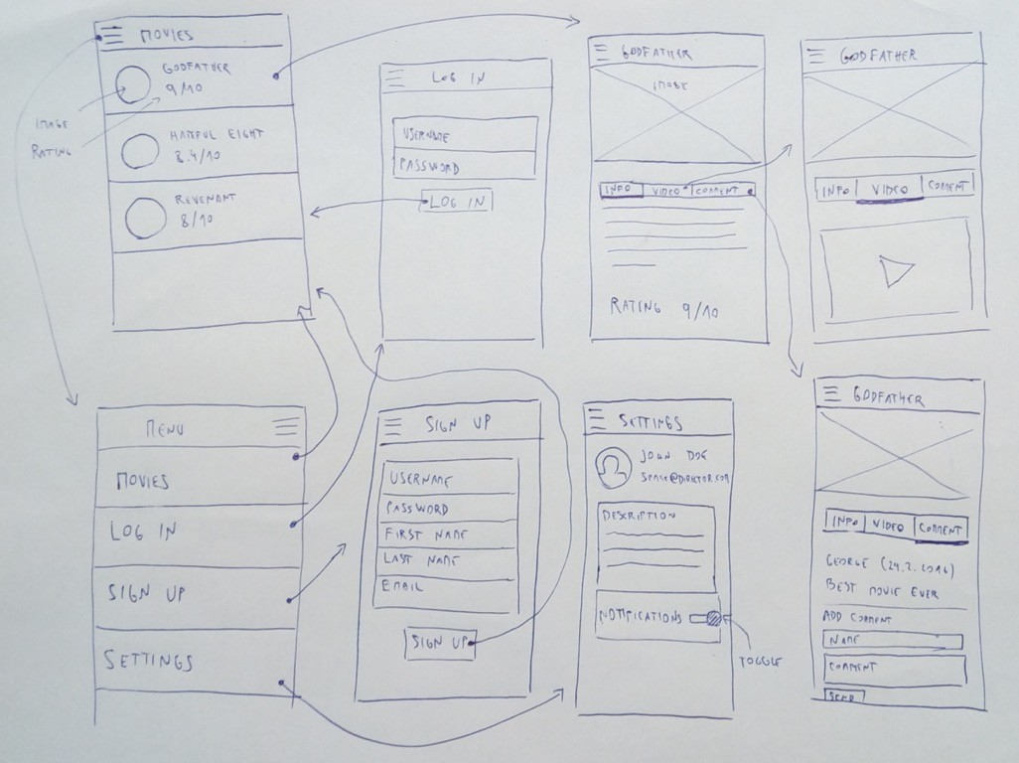
H O M E W O R K
creator.ionic.io
/53
51

Slide 48
Q U E S T I O N S ?

